Slide 1
Why this project?
After researching keyword-based web crawling and its applications, i understood its importance in automating data collection.
Example: while collecting data for research, i had to search google manually, open many links, and copy titles and urls one by one.
This manual process was time-consuming and sometimes led to missing or inconsistent data.
To solve this problem, i developed an automated keyword-based web crawler using python and google custom search api.

Slide 2

Keyword-Based Web Crawler using Google Custom Search API
Automating web data collection through intelligent keyword-based searching

Slide 3
TABLE OF CONTENTS
Overview of the Project
Importance of Keyword-Based Web Crawling
Core Components of the Web Crawler
Technical Stack Used
Workflow of the Web Crawler
Code Implementation and Demonstration
Output Structure
Benefits of the Web Crawler
Project Impact and Use Cases
Project Summary

Slide 4
PROJECT 1
Overview of the Project
What It Does
Key Capabilities
A Python-based system designed to collect keyword-specific data from the web automatically. It searches selected platforms and stores structured results in CSV format, eliminating manual data collection efforts.
Automated keyword-based searches across multiple platforms
Intelligent data extraction and structuring
Export results in convenient CSV format
Customisable search parameters

Slide 5

Why Keyword-Based Web Crawling Matters
Improved Accuracy
Eliminates human error in data collection. Consistent extraction methods ensure reliable, standardised results every time.
Time Efficiency
Manual searching can take hours or days. Automation reduces this to minutes, allowing teams to focus on analysis rather than data collection.

Slide 6
Core Components of the Web Crawler
01
02
03
Crawler Engine
Keyword Processor
URL Frontier
The main orchestrator that coordinates all crawling activities and manages the overall workflow of the system.
Handles keyword input validation, formatting, and prepares search queries for optimal API performance.
Manages the queue of URLs to be crawled, ensuring efficient and systematic coverage of target websites.
04
05
Data Extractor
Storage Module
Parses and extracts relevant information from search results, filtering out noise and unnecessary data.
Structures and saves extracted data in CSV format, maintaining data integrity and accessibility for future use.

Slide 7
TECHNOLOGY STACK
Technical Stack Used
Python
Requests Library
Pandas
Core programming language providing flexibility, extensive libraries, and easy integration with APIs.
Handles HTTP requests to Google Custom Search API, managing connections and response handling efficiently.
Powers data manipulation and CSV export functionality, ensuring clean and structured output files.
JSON
Google Custom Search API
Manages API response parsing and data serialisation for seamless data transfer between components.
Provides programmatic access to Google search results, enabling targeted and efficient web crawling.

Slide 8





Workflow of the Web Crawler
A streamlined four-step process that transforms keyword input into structured, actionable data ready for analysis.
Keyword Input
User enters the target keyword through the system interface
API Query
System sends request to Google Custom Search API for selected websites
Data Extraction
Results are parsed, cleaned, and structured into organised format
CSV Export
Final data saved as CSV file ready for analysis and use

Slide 9


IMPLEMENTATION
Code Implementation and Demonstration
Output Sucture
Page titles
URLs
Content snippets
Timestamps
Source platforms

Slide 10
Benefits of the Web Crawler
1
2
Time Savings
Automated Collection
Reduces hours of manual searching to minutes of automated processing, freeing up valuable resources for analysis and decision-making.
Eliminates repetitive manual tasks through intelligent automation. Schedule crawls and collect data without constant supervision.
3
4
Accuracy & Consistency
Reusable Output
Maintains uniform data quality across all searches. Standardised extraction methods ensure reliable, error-free results every time.
CSV format enables easy integration with analytics tools, databases, and reporting systems for ongoing research and analysis.

Slide 11
Project Impact and Use Cases
Market Research
Academic Studies
Content Monitoring
Track competitor activities, pricing strategies, and product launches across multiple platforms automatically.
Gather research data, citations, and references efficiently for literature reviews and scholarly work.
Track brand mentions, sentiment, and industry trends across various websites and platforms.

Slide 12
Project Summary
Key Achievements
90%
Successfully implemented Python-based keyword crawler using Google Custom Search API
Time Saved
Achieved automated data collection with structured CSV output
100%
Reduced manual research time by over 90%
Accuracy Rate
Created reusable, scalable solution for ongoing data needs
"Transforming hours of manual work into minutes of automated efficiency through intelligent web crawling technology."

Slide 13
TABLE OF CONTENTS
Overview of the Project
Importance of Email Automation
Key Features of Email Automation
Technical Stack Used
Code Implementation and Demonstration
Use Cases of Email Automation
Difficulties Faced During the Project
Future Scope of Email Automation
Conclusion

Slide 14

PROJECT 2
Email Automation System using SMTP
Overview of the Project
A Python-based email automation system designed to streamline communication processes. The system intelligently handles email delivery with attachments, eliminating the need for manual intervention whilst maintaining security and reliability.
Automated email dispatch with minimal configuration
Seamless attachment handling for reports and documents
Reduces manual workload by automating routine communications
Built with scalability and security in mind

Slide 15




Importance of Email Automation
Understanding why automation transforms business communication
Time Efficiency
Timely Communication
Eliminates hours of manual email composition and sending, allowing teams to focus on strategic tasks rather than repetitive communication workflows.
Ensures critical information reaches stakeholders exactly when needed, maintaining consistent delivery schedules without human oversight.
Error Reduction
Removes the risk of human mistakes such as incorrect recipients, missing attachments, or inconsistent messaging across communications.

Slide 16
Key Features of Email Automation
System Capabilities That Matter
1
2
3
Secure SMTP Authentication
File Attachment Support
Dynamic Email Content
Seamlessly attach CSV files, PDFs, reports, and other documents. The system handles various file formats with automatic encoding and validation.
Generate personalised email content programmatically, allowing for customised messages based on recipient data, report parameters, or system events.
Industry-standard authentication protocols ensure that all email communications are verified and protected against unauthorised access.

Slide 17





TECHNOLOGY STACK
Technical Stack Used
Python
email.message
Core programming language providing robust libraries and extensive email handling capabilities.
Comprehensive library for constructing MIME-compliant email messages with headers and attachments.
smtplib
SSL Encryption
Python's built-in SMTP protocol client for establishing secure connections to mail servers.
Transport Layer Security ensuring all email transmissions are encrypted and protected from interception.

Slide 18

Code Implementation and Demonstration
The CSV generated by the web crawler is automatically used as input for the email automation system to deliver reports.

Slide 19

Use Cases of Email Automation
Automated Report Delivery
Notifications and Alerts
Daily, weekly, or monthly reports automatically generated and delivered to stakeholders. Sales summaries, financial statements, and performance metrics arrive in inboxes without manual intervention.
Real-time system notifications for critical events—server downtime, threshold breaches, security alerts, or transaction confirmations trigger immediate email notifications to relevant personnel.
System-Generated Summaries
Automated compilation of data insights, log summaries, and operational reports. The system intelligently aggregates information and formats it into digestible email summaries.

Slide 20



Difficulties Faced During the Project
SMTP Authentication Setup
Configuring proper authentication with various email providers required navigating different security protocols, app-specific passwords, and port configurations.
File Path Handling
Managing file paths across different operating systems and ensuring attachments were correctly encoded and accessible presented initial complications.
Security Restrictions
Overcoming corporate firewall restrictions, SSL/TLS certificate validation, and implementing secure credential storage without hardcoding sensitive information.

Slide 21



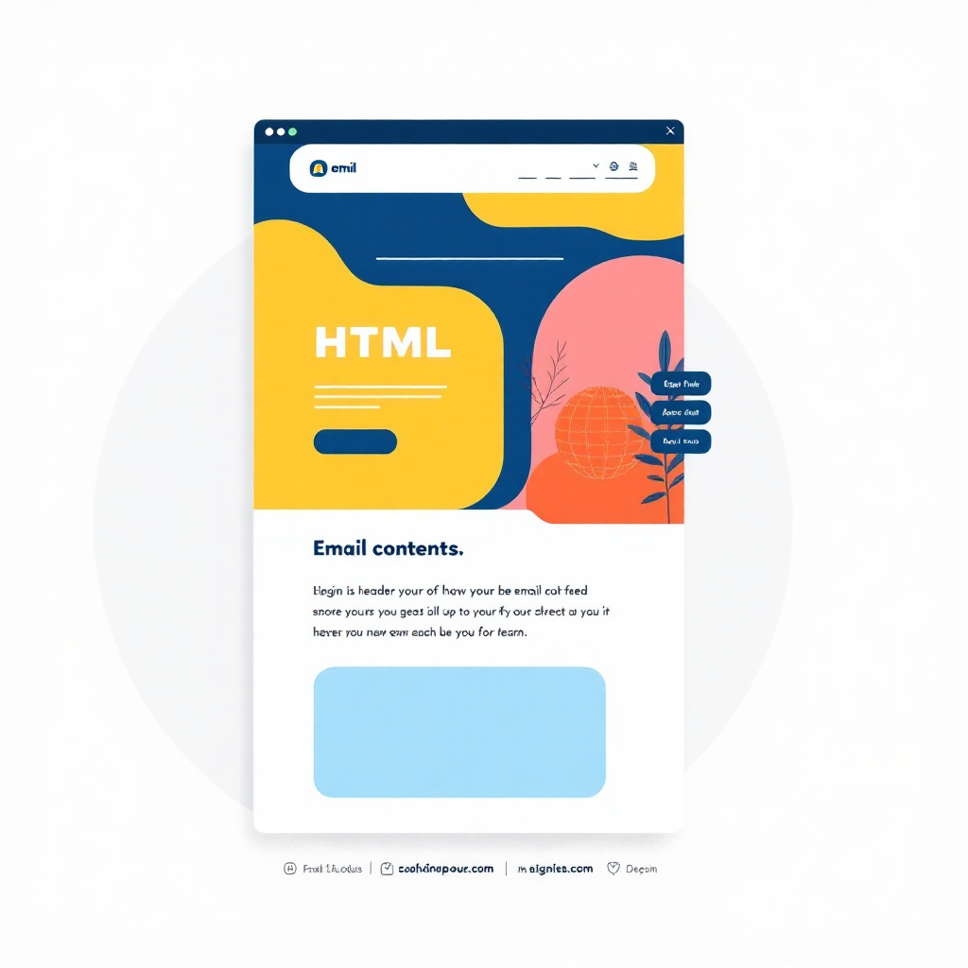
FUTURE DEVELOPMENT
Future Scope of Email Automation
Bulk Email Support
Scheduled Emails
HTML Email Templates
Implement functionality to handle mass email distributions with
personalised content for each recipient,
including mail merge capabilities.
Add cron job integration or task scheduler support to enable time-based email delivery at specific intervals or predetermined times.
Develop rich HTML templates with embedded images, styled layouts, and responsive designs for more engaging email communications.

Slide 22

Conclusion
Successfully Automated
Improved Efficiency
Delivered a fully functional email reporting system that operates reliably without manual intervention.
Demonstrated measurable time savings and enhanced reliability in critical business communications.
Real-World Python Automation
Showcased practical Python implementation solving genuine business challenges with production-ready code.
The email automation system represents a significant step towards modernising communication workflows, proving that intelligent automation can deliver tangible business value whilst maintaining security and reliability standards.

